Slide 1
GDP, Electricity Consumption, and CO2 Emissions around the Globe
Anubha Srivastava, Lisa Chille, and Grant Riew

Slide 2
Goals/Tasks
observe the correlation between energy consumption, GDP per capita, and potentially even pollution rates
display trends throughout the years
encourage others to decrease unnecessary energy consumption
project future trends for electricity consumption and carbon emissions
determine if there is a significant correlation between C0₂ emissions and electricity consumption based on the GDP per capita

Slide 3
Planned Implementation
choropleth map
Tool tips
Linked graphs?
Comparative bar chart/line graph/bubble plot

Slide 4
Data!
Data from the Worldbank
GDP at Market Prices
http://data.worldbank.org/indicator/NY.GDP.MKTP.CD ← Nice CSV File
Electricity Consumption (etc)
C02 Emissions (etc)
World JSON Map (anyone know the best place to find the most reputable one?)
Renewable energy data for extra visualizations?

Slide 5
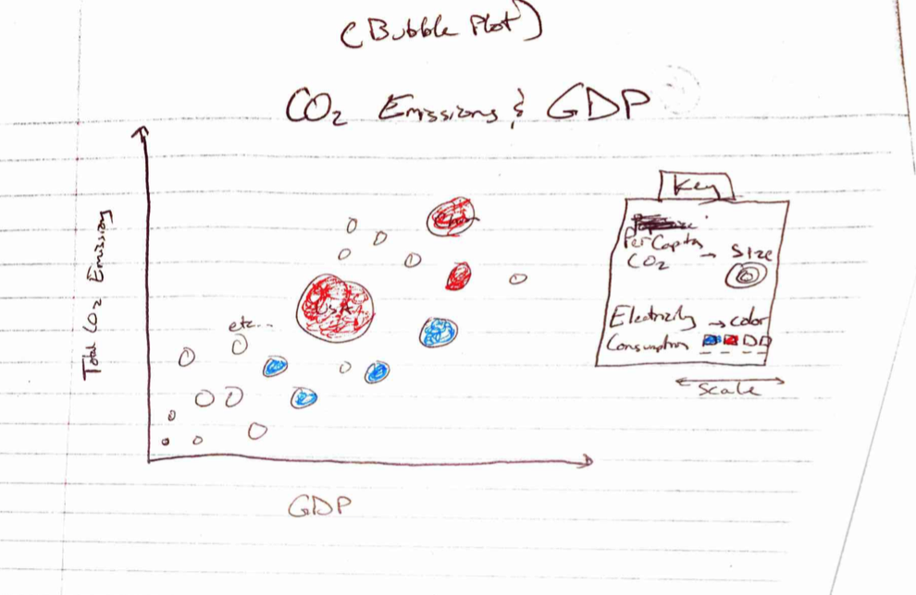
Just a few Sketches…

Slide 6
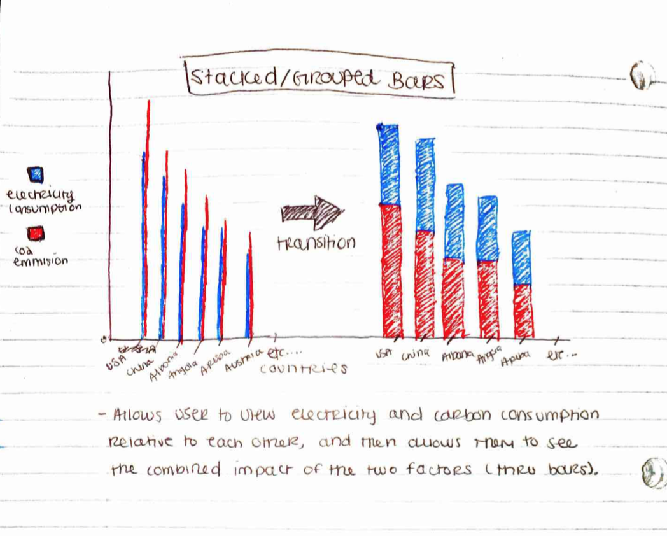
Stacked/Grouped Bars

Slide 7
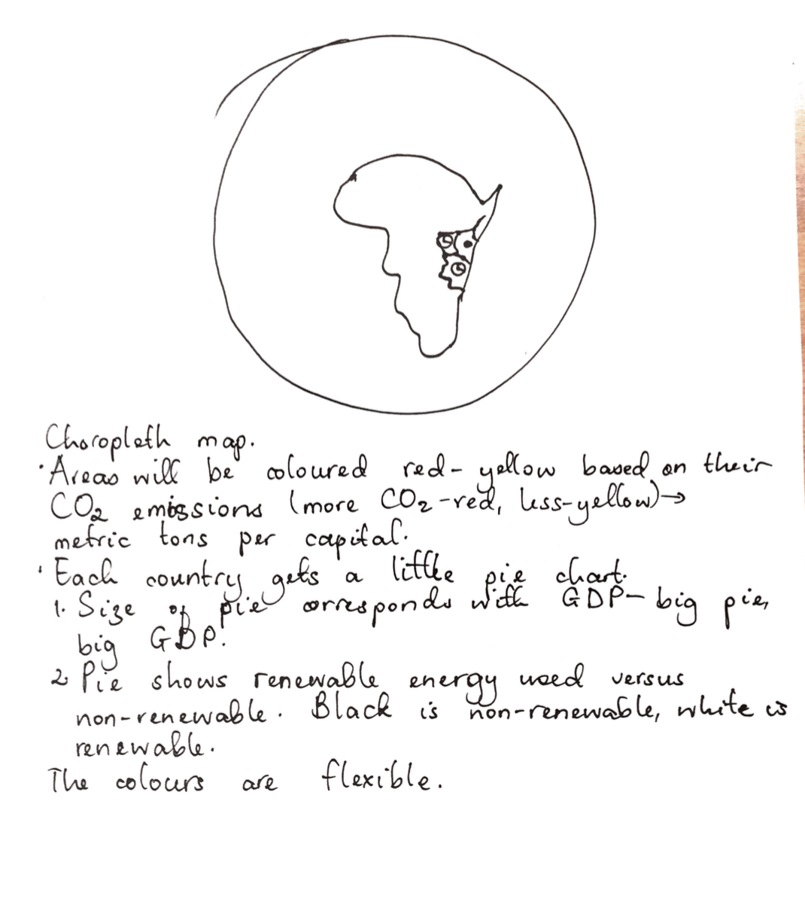
Choropleth

